Slide 1

ELLIPTIC CURVE CRYPTOGRAPHY
& PROJECT HOSTING GATEWAY
Group - 26
Project Guide:
Mr. Utpal Kumar Ray
Group Members:
Lekharshav Sengupta- 002211001121
Rounak Saha - 002211001132
Aditya Chowdhury - 002211001133

Slide 2
CONTENTS
  Elliptic Curve
  Elliptic Curve Group Over Finite Prime Field
  Elliptic Curve Discrete Logarithm Problem (EDLP)
  Generator Point
  Sagemath
  Algorithms
  Web Architecture
  ECA Tools workflow
9. Curve Point Visualization
10. Project Hosting Gateway
11. Deployment on Render
12. Functional Testing
13. Challenges & Issues Faced
14. Future Goals
15. REFERENCES

Slide 3
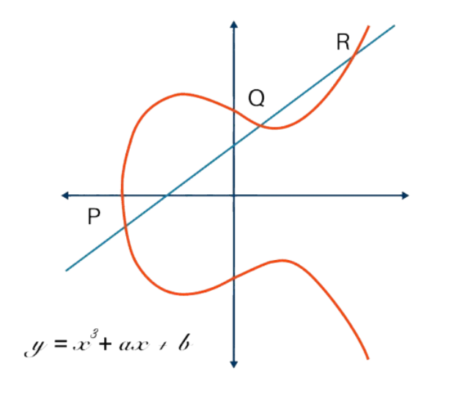
ELLIPTIC CURVE
  Elliptic Curve Cryptography (ECC) is a public-key cryptography technique that uses elliptic curve theory to encrypt, authenticate, and digitally sign data.
y² = x³ + ax + b (mod p)
  ECC operates on points on the curve, not integers.
  Symmetric with respect to the x-axis.
  Forms a finite group structure used in cryptographic
algorithms.
Use in Cryptography:
  ECC uses these points for secure key generation.
  Cryptography uses elliptic curves in a simplified form
(Weierstrass form)

Slide 4
Elliptic Curve Group Over Finite Prime Field (Fm):
The elliptic curve cryptography (ECC) uses elliptic curves over the finite field ,most commonly 𝔽p (where p is prime and p > 3) and the binary extension field 𝔽2ᵐ (where the fields size p = 2m).
  A finite field is a finite set of elements with defined arithmetic operations. In 𝔽p the elements are integers modulo p, while in 𝔽2ᵐ they are binary polynomials. The curve points have coordinates from the field, resulting in a finite number of points.
  All algebraic operations within the field, such as point addition and scalar multiplication, produce another point that also lies within the same field.
  The elliptic curve equation over the finite field 𝔽p takes the following modular form:
y² = x³ + ax + b (mod p)
An elliptic curve over the finite field 𝔽p consists of:
• A set of integer coordinates {x, y}, such that 0 ≤ x, y < p
• Staying on the elliptic curve: y² = x³ + ax + b (mod p)

Slide 5
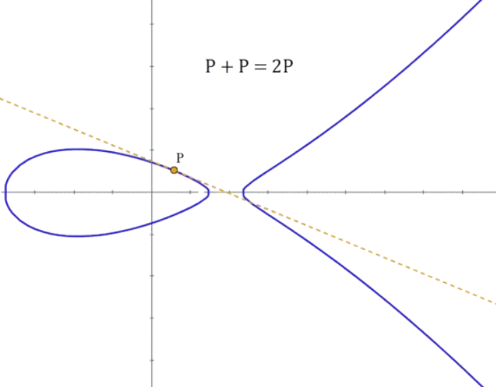
GENERATOR POINT
  For the elliptic curves over finite fields, the ECC cryptosystems define a special predefined (constant) EC point called generator point G (base point), which can generate any other point over the elliptic curve by multiplying G by some integer in the range [0...r]. The number r is called "order“.
  Order of G (x,y) = Curve Order (a, b, p)
  Every point on the curve can be expressed as a multiple of G
  Points on Curve={O,G,2G,…,(n−1)G}

Slide 6
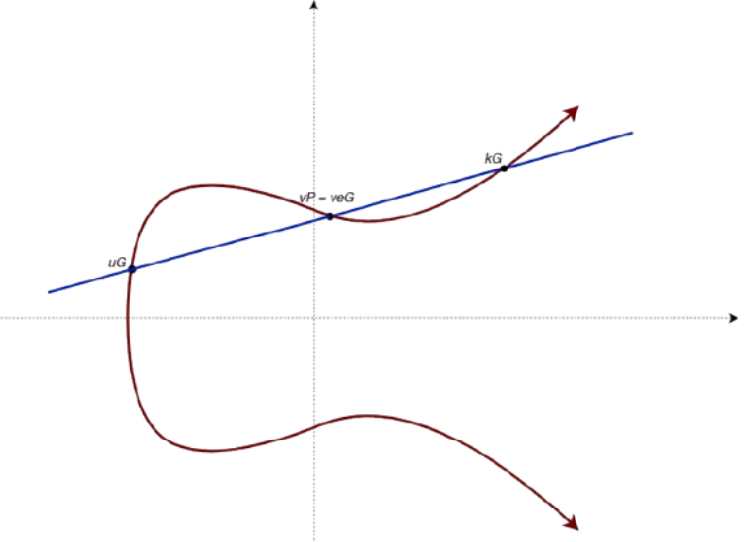
Elliptic Curve Discrete Logarithm Problem (EDLP)
The Problem
  Easy Direction: Given k and P, it is easy to calculate Q (Scalar Multiplication)
  Hard Direction: Given Q and P, it is computationally infeasible to determine k.
Why It Matters
  This "one-way" function is the foundation of ECC security.
  Because ECDLP is harder than factoring integers (RSA), we can use much smaller keys for the same security level.
Q = k x P
P: Generator Point (Known)
k: Private Key (Integer / Scalar)
Q: Public Key (Resulting Point)

Slide 7

Sagemath
  SageMath is an open-source mathematics software system based on Python.
  Widely used in cryptography and number theory
  It provides built-in, high-level functions for handling complex algebraic structures.
Provides native support for:
  Finite fields
  Elliptic curves
Use of Sagemath:
  Defined and validated elliptic curves over both prime fields GF( p ) and extension fields GF( pⁿ ).
  Computed point order Point.order() and generator points E.gens()
- EC point operations:
  Scalar multiplication
  Point addition

Slide 8
Algorithm for ORDER of an EC over a FINITE FIELD
Algorithm
Step 1: Parse Arguments
Parse the cmd line arguments to identify the base field prime (p),the extension degree (n),and the method of coefficient selection (manual or random ).
Step 2: Construct Field
Construct the finite field K = GF(pⁿ). If n > 1, define the field using a generator (a) to handle polynomial representations of field elements.
Step 3:Assign Coefficients
Assign values to the coefficients a₁, a₂, a₃, a₄, a₆:
  If Choice_of_Coeff is 0: Convert the provided command line strings into field elements(integers when n = 1, or polynomials in (a) when n > 1).
  If Choice_of_Coeff is 1:Generate a random element from the field K for each of the five coefficients.
Input Parameters:
  Base_Field (p)
  Degree (n)
  Choice_of_Coeff (binary flag)
  Optionally, the coefficients a₁, a₂, a₃, a₄, a₆ for the general Weierstrass equation
y² + a₁xy + a₃y = x³ + a₂x² + a₄x + a₆ defined over the field GF(pⁿ).

Slide 9
Algorithm for ORDER of an EC over a FINITE FIELD
Algorithm (cont.)
Step 4:Define Curve
Define the elliptic curve E over the field K using the general Weierstrass model.
Step 5:Compute Order
Compute the order of the curve (N) using the built-in E.order() function, which applies optimized point-counting algorithms .
Step 6:Find Generators
Identify a set of generator points for the group of points on the curve using E.gens().
Step 7:Check Primality
Perform a primality test on the calculated Curve_Order.
Step 8:Display Results
Return and display:
  the elliptic curve equation,
  its total order (specifying if it is prime), and
  the identified generator points.

Slide 10
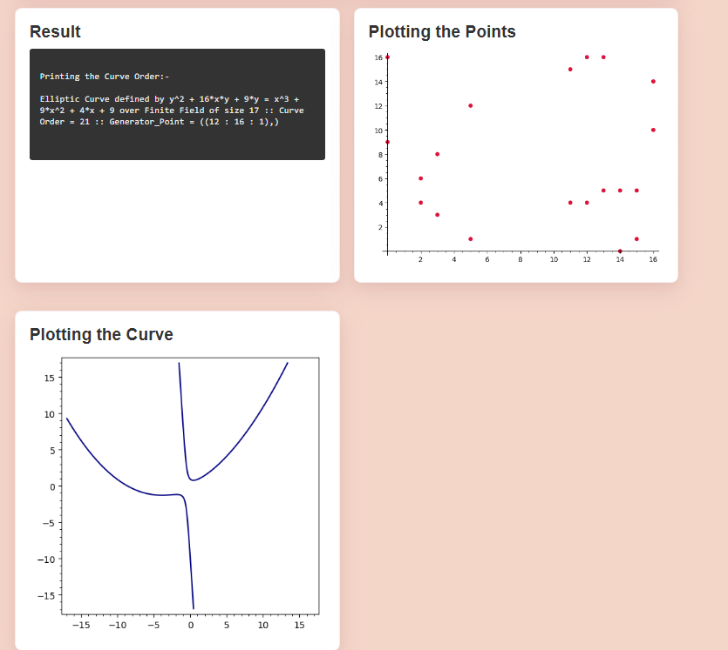
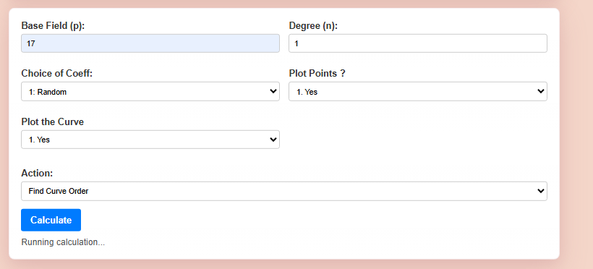
https://be-projects-2026.onrender.com/tools/ECA_Tools/
Web Application & Results
  EC Order with Random Coeff :

Slide 11
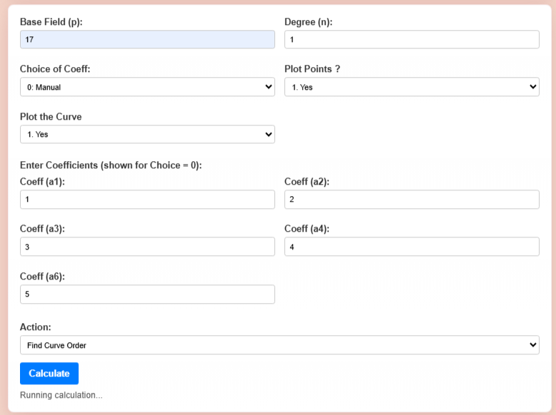
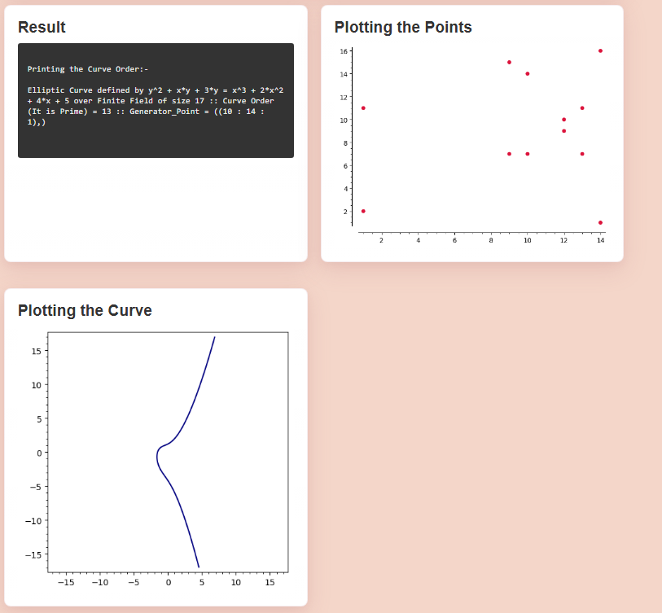
https://be-projects-2026.onrender.com/tools/ECA_Tools/
Web Application & Results (cont.)
2. EC Order with Manual Coeff :

Slide 12
Algorithm for listing Curve Points and their Orders
Input Parameters:
The script takes seven input parameters via command-line arguments:
  Base_Field: A prime number representing the characteristic of the field
  Degree: The degree of the extension field
  Coeff_a₁, Coeff_a₂, Coeff_a₃, Coeff_a₄, Coeff_a₆: The five coefficients of the General Weierstrass equation
y² + a₁xy + a₃y = x³ + a₂x² + a₄x + a₆
Algorithm
Step 1:
Validate the Base_Field. If the provided value is not prime,determine and use the next available prime number.
Step 2:
Define the finite field K using the validated Base_Field and the given Degree.
Step 3:
Initialize the elliptic curve E over the field K using the provided coefficients
(a₁, a₂, a₃, a₄, a₆).
Step 4:
Determine the symmetry of the curve:
  If both a₁ and a₃ are zero, mark the curve as Symmetric across the X-axis (suitable for cryptographic applications).
  Otherwise, mark the curve as Non-Symmetric.

Slide 13
Algorithm for listing Curve Points and their Orders
Algorithm (cont.)
Step 5:
Compute the Curve_Order (total number of points on the curve) and generate the complete list of points (Lst_of_Pts), including the point at infinity.
Step 6:
Print the first point, which is the Point at Infinity O, along with its order.
Step 7:
Iterate through the remaining points in the list:
  If the curve is Symmetric:
    If a point lies on the X-axis (y = 0), print the point individually along with its order.
    If a point does not lie on the X-axis, print the point together with its vertical reflection as a pair, displaying their common order.
  If the curve is Non-Symmetric:
    Iterate through all remaining points and print each point individually along with its calculated order.

Slide 14
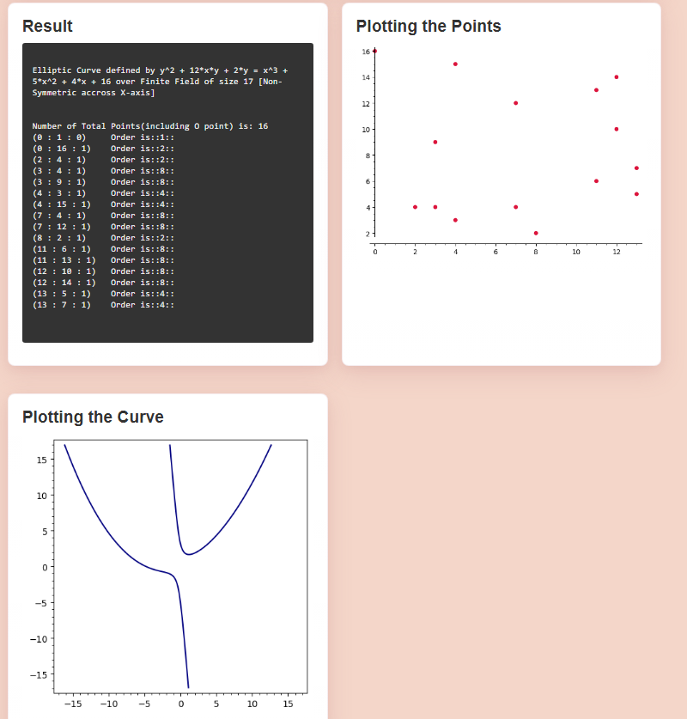
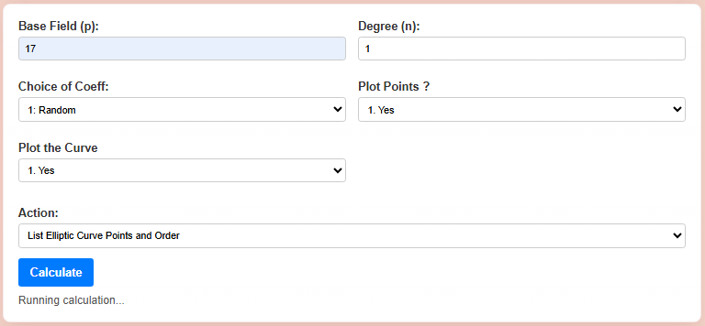
https://be-projects-2026.onrender.com/tools/ECA_Tools/
Web Application & Results
  List EC Points and Order :

Slide 15
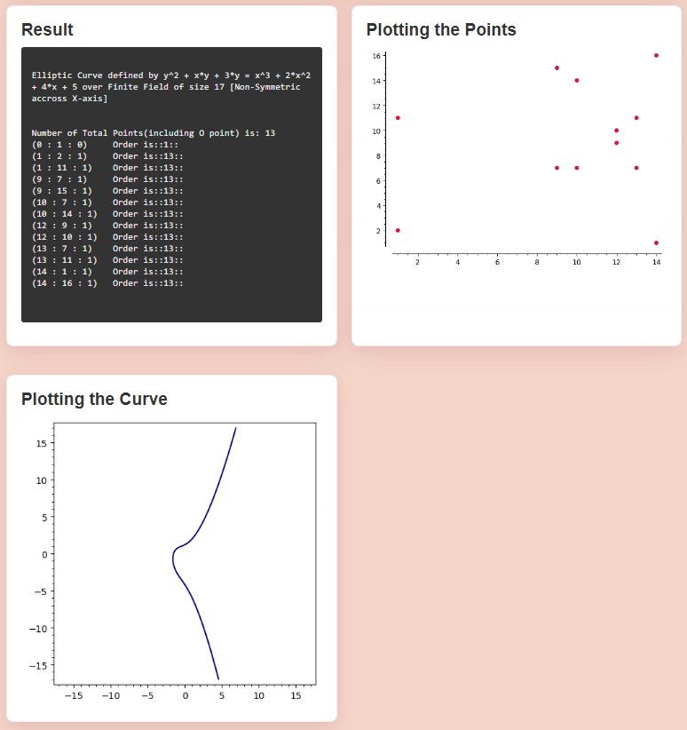
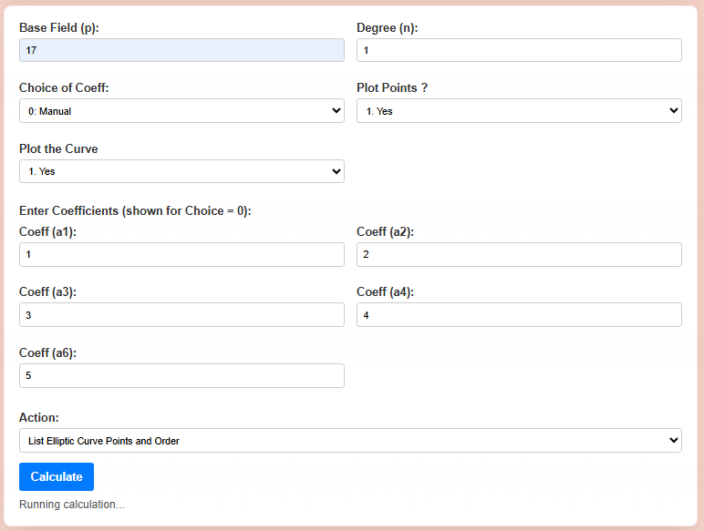
https://be-projects-2026.onrender.com/tools/ECA_Tools/
Web Application & Results (cont.)
2. EC Order with Manual Coeff :

Slide 16
Algorithm for Point Add
Input Parameters:
The script takes seven input parameters via command-line arguments:
  Base_Field: A prime number representing the characteristic of the field
  Degree: The degree of the extension field
  Coeff_a₁, Coeff_a₂, Coeff_a₃, Coeff_a₄, Coeff_a₆: The five coefficients of the General Weierstrass equation
  x₁, y₁(Coordinates of point P)
  x₂, y₂(Coordinates of point Q)
y² + a₁xy + a₃y = x³ + a₂x² + a₄x + a₆
Algorithm
  Read finite field parameters p and n.
  Construct finite field GF(pⁿ).
  Read curve coefficients a₁, a₂, a₃, a₄, and a₆.
  Create elliptic curve E using the general Weierstrass equation.
  Construct point P = (x₁, y₁).
  Construct point Q = (x₂, y₂).
  Verify that both points belong to E.
  Invoke SageMath elliptic curve addition operation.
  Compute: R = P + Q
  Convert result into printable format.
  Return point R.

Slide 17
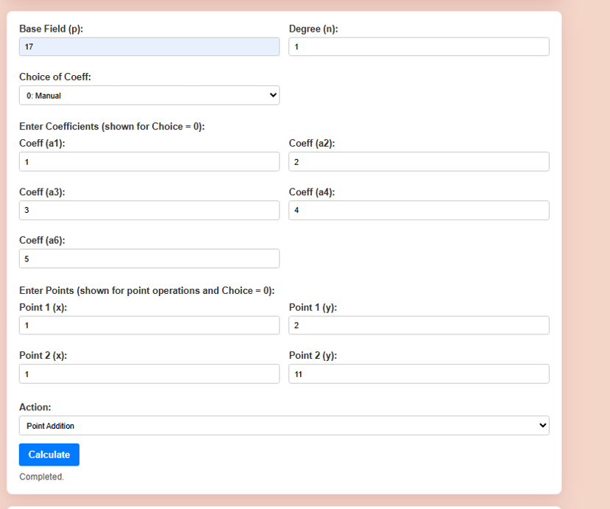
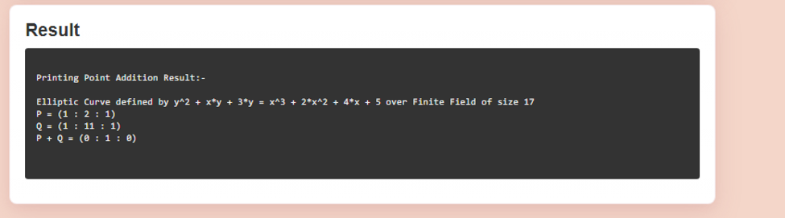
https://be-projects-2026.onrender.com/tools/ECA_Tools/
Web Application & Results

Slide 18
Algorithm for Point Subtract
Input Parameters:
The script takes seven input parameters via command-line arguments:
  Base_Field: A prime number representing the characteristic of the field
  Degree: The degree of the extension field
  Coeff_a₁, Coeff_a₂, Coeff_a₃, Coeff_a₄, Coeff_a₆: The five coefficients of the General Weierstrass equation
  x₁, y₁(Coordinates of point P)
  x₂, y₂(Coordinates of point Q)
y² + a₁xy + a₃y = x³ + a₂x² + a₄x + a₆
Algorithm
  Read finite field parameters.
  Construct GF(pⁿ).
  Create elliptic curve E from supplied coefficients.
  Construct points P and Q.
  Verify point validity on E.
  Determine additive inverse of Q.
  Perform elliptic curve addition: P − Q = P + (−Q)
  Compute result using SageMath group operations.
  Format output.
  Return resulting point.

Slide 19
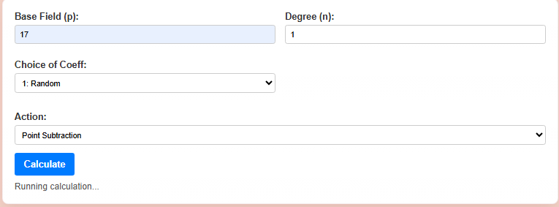
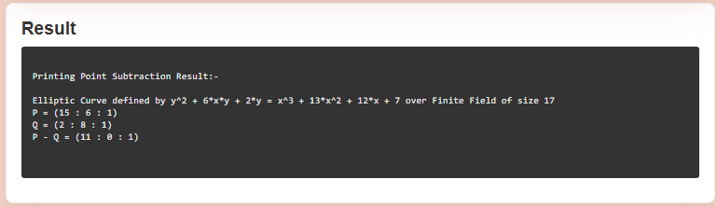
https://be-projects-2026.onrender.com/tools/ECA_Tools/
Web Application & Results

Slide 20
Algorithm for Point Multiply
Input Parameters:
The script takes seven input parameters via command-line arguments:
  Base_Field: A prime number representing the characteristic of the field
  Degree: The degree of the extension field
  Coeff_a₁, Coeff_a₂, Coeff_a₃, Coeff_a₄, Coeff_a₆: The five coefficients of the General Weierstrass equation
  x₁, y₁(Coordinates of point P)
  k (Scalar multiplier)
y² + a₁xy + a₃y = x³ + a₂x² + a₄x + a₆
Algorithm
  Read finite field parameters.
  Construct finite field GF(pⁿ).
  Create elliptic curve E.
  Construct point P on E.
  Read scalar value k.
  Verify validity of P.
  Invoke SageMath scalar multiplication operation.
  Compute: R = k × P
  Convert result into display format.
  Return point R.

Slide 21
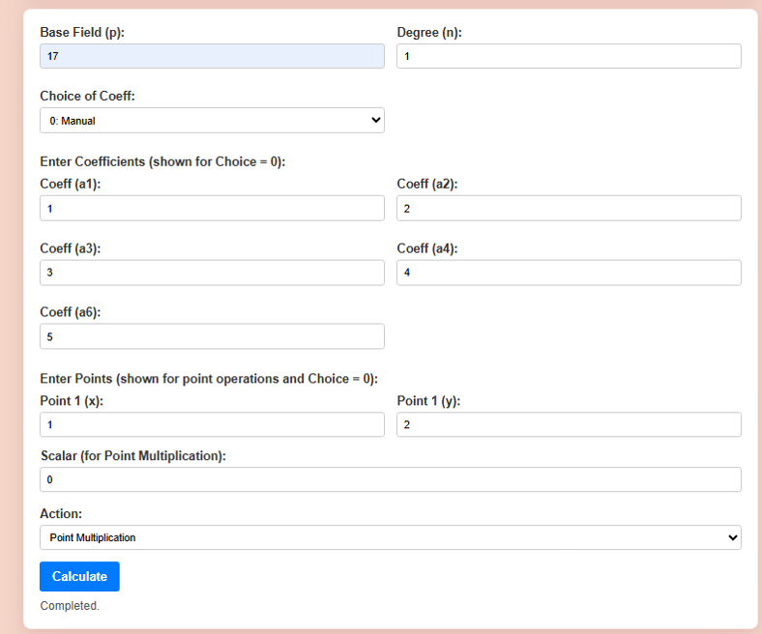
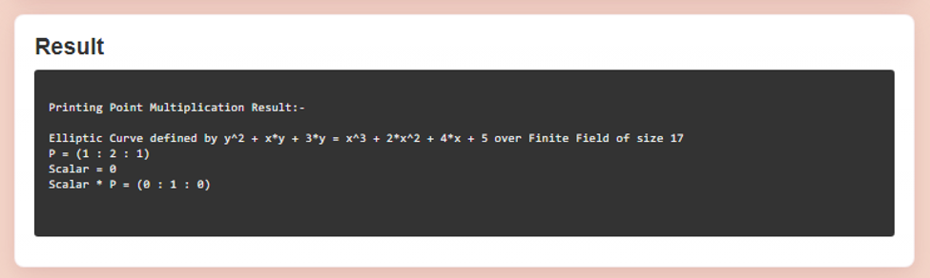
https://be-projects-2026.onrender.com/tools/ECA_Tools/
Web Application & Results

Slide 22






System Architecture :
ECA Tool :
Project Hosting :
  Flask web application
  SageMath backend scripts (one per operation)
  HTML/CSS/JS templates ( Frontend )
  Docker configuration
  Gunicorn WSGI server
  Homepage Flask app
  DispatcherMiddleware router
  /tools/ECA_Tools mount point
  Sample template for future groups
Tech Stack :

Slide 23
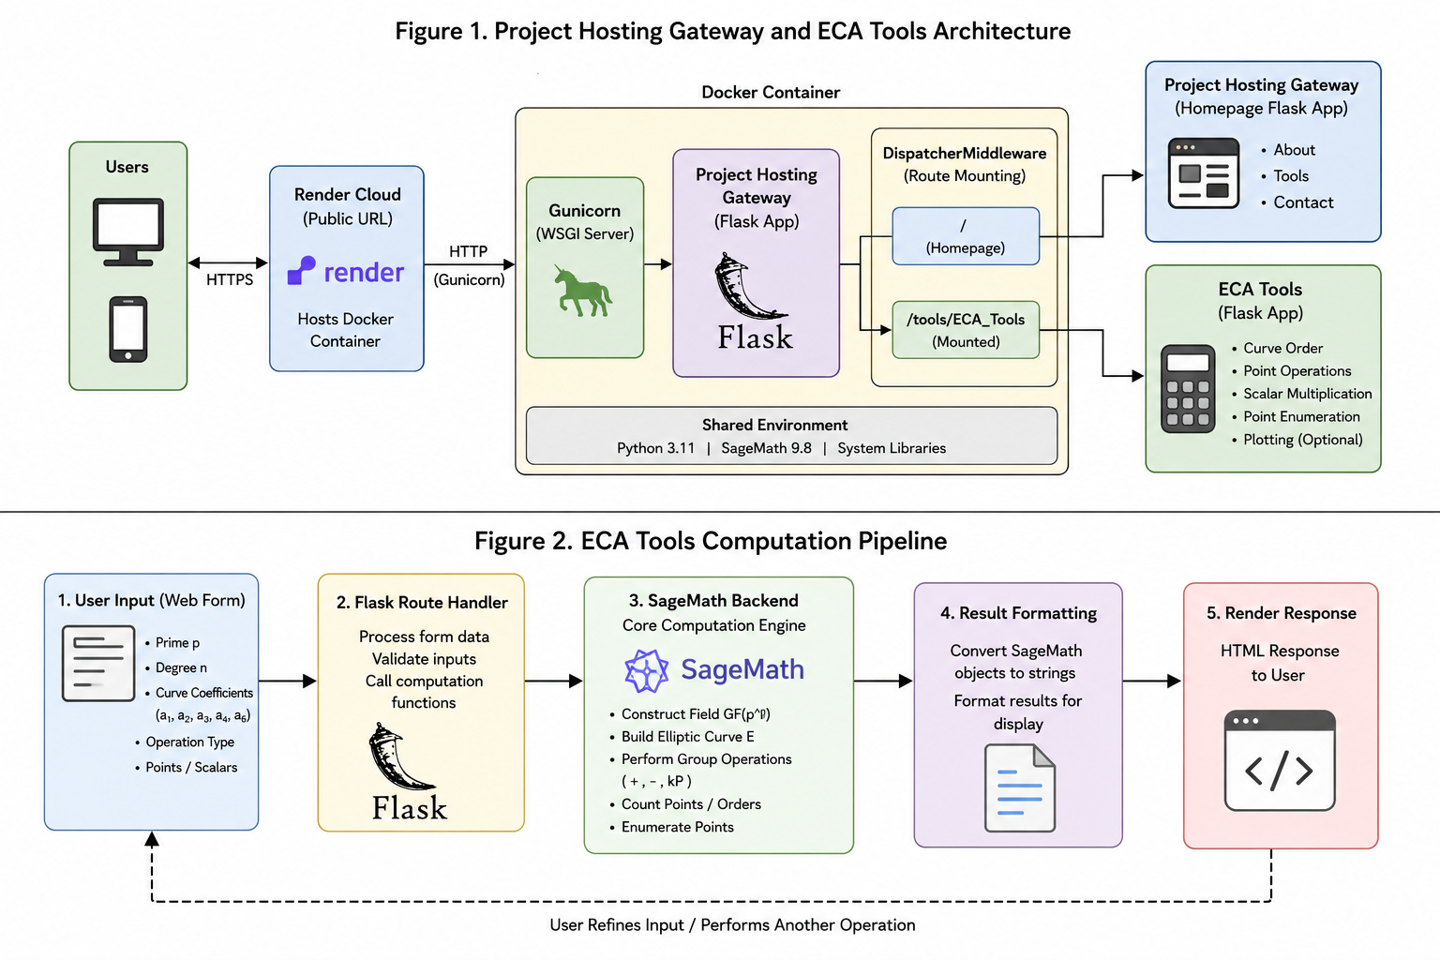
System Architecture :

Slide 24
ECA Tools Workflow :
The ECA Tools application follows a modular request-processing pipeline. User inputs are collected through a Flask-based web interface and validated before computation. Depending on the selected operation, the corresponding SageMath backend script is executed as a managed subprocess. SageMath performs all finite field and elliptic curve calculations, ensuring mathematical correctness. The computed results are then formatted and returned to the browser in a user-friendly format.
Processing Steps:
  User enters elliptic curve parameters and selects an operation.
  Flask route validates the input data.
  Appropriate SageMath script is selected.
  Finite field GF(p) or GF(pⁿ) is constructed.
  Elliptic curve object is created.
  Requested operation is performed:
    Curve Order
    Point Listing
    Point Addition
    Point Subtraction
    Scalar Multiplication
  Results are formatted for display.
  Output is returned to the web interface.
Key Features:
  Supports both GF(p) and GF(pⁿ).
  Uses SageMath for exact mathematical computation.
  Implements managed subprocess execution.
  Includes 120-second timeout protection.
  Supports optional curve and point visualization for degree-one fields.

Slide 25
ECA Tools Workflow :

Slide 26
Curve and Point Visualization Module
The Plot Curve and Plot Points module provides a graphical representation of elliptic curves and their corresponding points over finite fields. It helps users visually understand the geometric structure of elliptic curves and verify computational results obtained from SageMath.
Workflow :
  User enables Plot Curve or/and Plot Points option.
  Flask application passes parameters to SageMath for Plot points with E.points() .
  Flask receives the point list.
  Python plotting library (Matplotlib) generates the scatter plot.
  Plot images are converted to Base64 format.
  Images are embedded directly into the web response.
Key Features:
  Visualizes elliptic curves for degree-one fields GF(p).
  Displays all valid points lying on the curve.
  Supports plotting alongside: Curve Order Calculation & Point Enumeration
  Automatically generated from user-provided curve coefficients.
  Helps in educational demonstration and verification of curve arithmetic.
Limitation:
  Plotting is currently restricted to GF(p) (n = 1).
  Extension fields GF(pⁿ) for n > 1 are not visualized because their elements do not have a natural two-dimensional Euclidean representation.

Slide 27
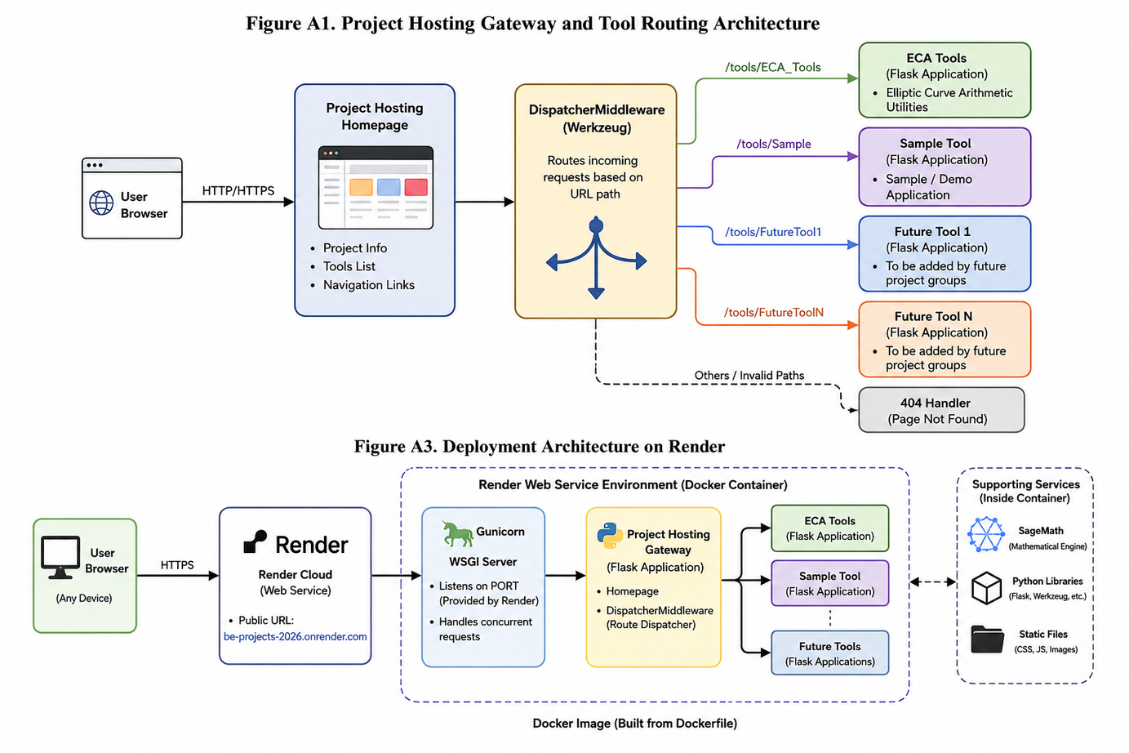
Project Hosting Gateway
Motivation:
Previous departmental projects were deployed independently, resulting in duplicated hosting effort, separate URLs, and no common platform for future projects.
Our Solution:
A centralized Project Hosting Gateway that allows multiple academic tools to be hosted under a single web application using Werkzeug DispatcherMiddleware.
Gateway Architecture

Slide 28
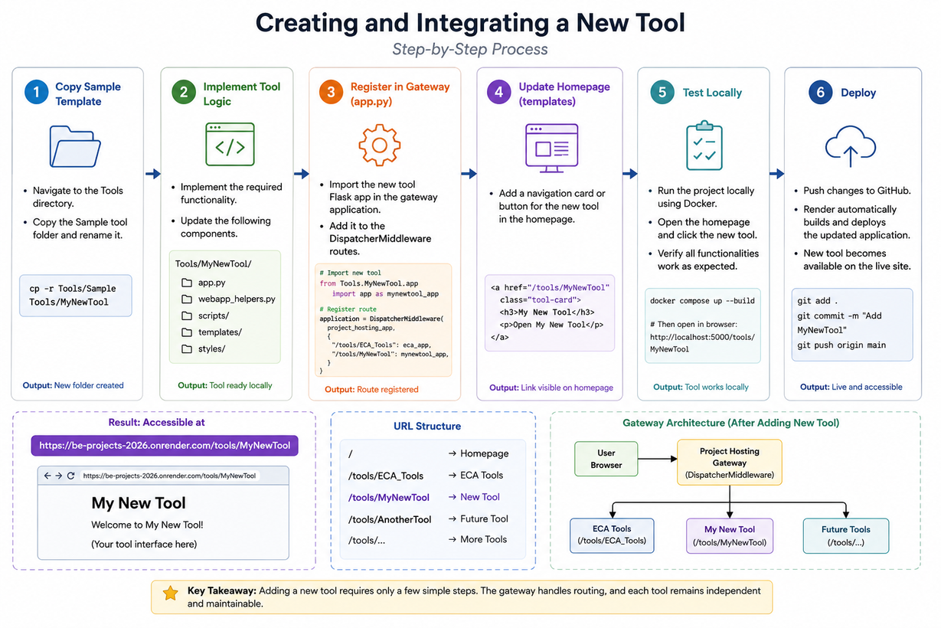
Project Hosting Gateway
Key Features
  Centralized Access -Single URL for all departmental tools. Consistent user experience.
  Independent Development - Each tool remains an independent Flask application.No shared business logic required.
  Route-Based Mounting
  Scalability -Additional tools can be integrated without modifying existing tool implementations.

Slide 29
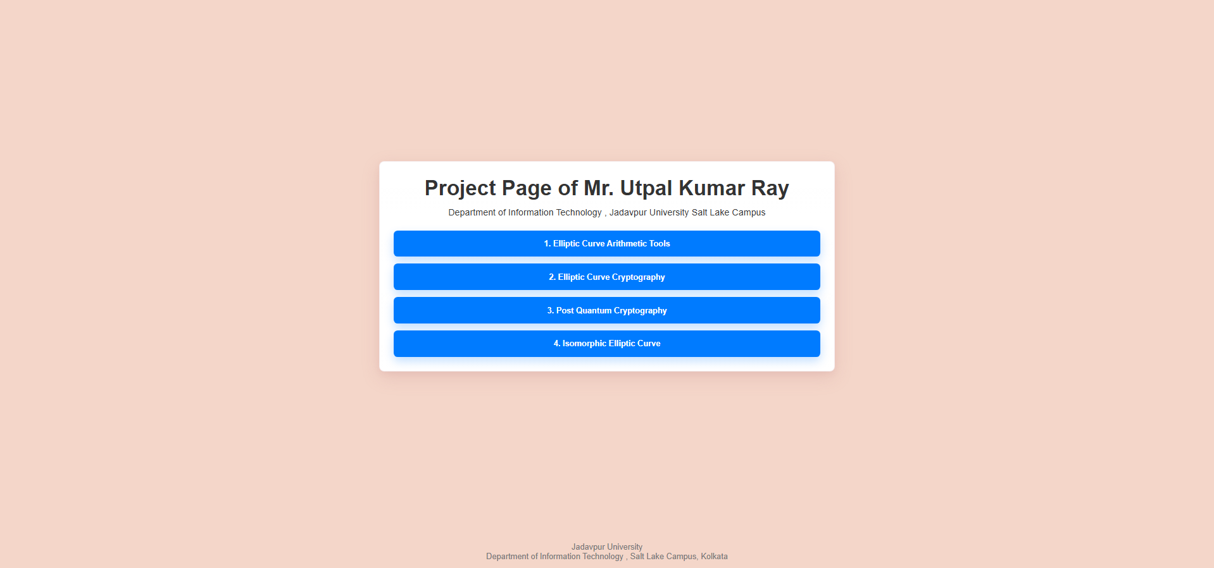
Project Hosting Homepage
ECA Tool mounted

Slide 30
https://be-projects-2026.onrender.com/tools/ECA_Tools/
Deployment on Render
Deploy the mounted ECA Tools inProject Hosting Gateway as a publicly accessible web application while maintaining a reproducible execution environment for SageMath computations.
Workflow :
  ECA Tools and Project Hosting repositories maintained in Git.
  Source code pushed to GitHub.
  Render automatically builds the Docker image.
  Render launches the Docker container and assigns a dynamic PORT.
  DispatcherMiddleware routes requests:
  SageMath Execution

Slide 31
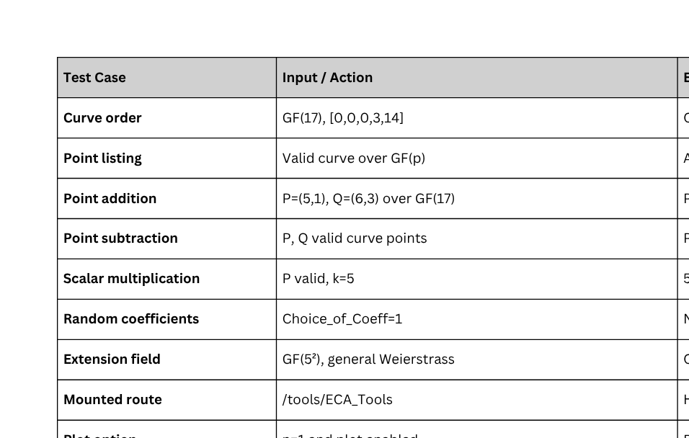
Functional Testing:

Slide 32
Challenges & Issues Faced:
1. Computation Latency
  Operations such as:
    Curve Order Calculation (E.order())
    Generator Point Detection (E.gens())
    Full Point Enumeration (E.points())
become computationally expensive for larger finite fields and extension fields GF(pⁿ).
Impact:
  Users may experience delays after pressing Calculate.
  Long-running SageMath processes can temporarily occupy server resources.
Mitigation Implemented:
  Managed subprocess execution.
  120-second timeout protection.
  Request replacement mechanism for duplicate requests.

Slide 33
Challenges & Issues Faced:
2. High Resource Consumption
  SageMath requires significantly more RAM and CPU resources than conventional web applications.
  Running a complete CAS inside Docker increases memory footprint.
  Resource requirements limited hosting options and influenced deployment choices.
Impact: Reduced suitability for lightweight free-tier cloud services.
3. High Docker Build Time
  SageMath is a large Computer Algebra System (CAS) with numerous mathematical libraries and dependencies.
  Docker images containing SageMath exceed several gigabytes in size.
  Container build and deployment times were significantly longer than traditional Flask applications.
  Frequent rebuilds during development slowed the testing cycle.
Impact: Longer deployment and update times.

Slide 34
Future Enhancements :
1. User Interface (UI) Enhancements on WebApp
  Visual Curve Plotting:
  Improve graphical visualization of elliptic curves.
  Provide richer interactive plots using: Plotly / Advanced Matplotlib integration
  Real-Time Validation:
  Validate coefficients while users type.
  Automatically detect singular curves. Δ = 0
  Display warnings before computation begins.
2. Performance Improvements
  Asynchronous Processing: Move computationally intensive SageMath operations to background workers.
  Possible technologies: Celery/Redis & Background Job Queues
  Benefit: Non-blocking user experience.
3. Expansion of ECA (Elliptic Curve Arithmetic) Tools
  Discrete Logarithm Solver (Small Scale): Add a module to demonstrate the difficulty of ECDLP by attempting to solve Q = kP for small curves, visually showing the computational effort required.

Slide 35
REFERENCES
[1] V. S. Miller, “Use of Elliptic Curves in Cryptography,” CRYPTO 1985, Lecture Notes in Computer Science, Vol. 218, Springer, pp. 417–426, 1986.
[2] N. Koblitz, “Elliptic Curve Cryptosystems,” Mathematics of Computation, Vol. 48, No. 177, pp. 203–209, 1987.
[3] J. H. Silverman, The Arithmetic of Elliptic Curves, Graduate Texts in Mathematics, Springer, 1986.
[4] L. C. Washington, Elliptic Curves: Number Theory and Cryptography, 2nd ed., Chapman and Hall/CRC, 2008.
[5] SageMath Developers, SageMath, the Sage Mathematics Software System. [Online]. Available: https://www.sagemath.org
[6] A. J. Menezes, P. C. van Oorschot, and S. A. Vanstone, Handbook of Applied Cryptography, CRC Press, 1996.
[7] Pallets Projects, Flask Documentation. [Online]. Available: https://flask.palletsprojects.com
[8] Pallets Projects, Werkzeug Documentation — DispatcherMiddleware. [Online]. Available: https://werkzeug.palletsprojects.com
[9] Docker Inc., Docker Documentation. [Online]. Available: https://docs.docker.com
[10] Render, Web Service Deployment Documentation. [Online]. Available: https://render.com/docs
[11] C. Bach, “Elliptic Curve Calculator,” [Online]. Available: http://christelbach.com/ECCalculator.aspx, 2010.
[12] Dr. S. Grau, “ECC Visualiser Tool,” [Online]. Available: https://graui.de/code/elliptic2/, 2011–2017.

Slide 36
THANK YOU FOR YOUR ATTENTION
Deployed
https://be-projects-2026.onrender.com/
Github https://github.com/AdityaChowdhury15/ECA_Tools/tree/main/2026

